Slide 1

Swarm Drones:
Critical Design Review
Client: Dr. Anthony Choi
Advisor: Dr. Hodge Jenkins
Notes:
Daniel

Slide 2

Presentation Outline
Introduction
2. Final Design & Construction
3. Checks, Tests, & Results
4. Safety & Sustainability Discussion
5. Conclusions, Critiques, & Recommendations
Notes:
Daniel

Slide 3
Introduction
Project Background
Required Specifications
Deliverables
Notes:
Daniel

Slide 4
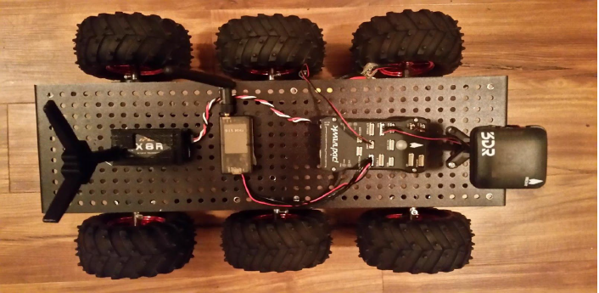
The Swarm Drones Project
R.E.D. Design was tasked to design, fabricate, and program an autonomous swarm drone system by Dr. Anthony Choi of Mercer University
The team resumed the project from a 2016 senior design team
Overhead view of previous project design [1]
Notes:
Daniel
Robots are becoming more prevalent in everyday life for a growing percentage of today’s society. Juxtaposed to the simple, repetitive tasks for which robots were initially employed, robots are now able to fabricate complex, convoluted designs with precision to the thousandth of an inch thanks to manufacturing processes such as Computer Numerical Control Additive/Subtractive Manufacturing. The use of robotics has increased due to its ability to simplify industrial processes; most notably, Amazon, the largest online-retailer corporation, has employed drones to improve their delivery services.
The client, Dr. Anthony Choi, Assistant Professor at Mercer University’s School of Engineering, Department of Electrical and Computer Engineering, had shown interest in autonomous swarm robots to expand the university’s collection. Swarm robots are able to travel in unison and communicate their location to one another. The current collection of robots consists of drones, rovers, and autonomous underwater vehicles. Dr. Choi uses the robots to promote Mercer University’s School of Engineering during events and on special occasions.
The team continued the work of a senior design team from 2016. The previous team’s vehicle served as a starting point for the development of the autonomous vehicles. The vehicles constructed by the previous team did not operate; each lacked some components as they had been recycled for different projects. Hence, the team salvaged all components for the implementation of a new design. The previous team recommended re-examining potential flight controllers. A list of the components used from the previous senior design team can be found in Appendix A

Slide 5
Required Design Specifications
Specification | Description
Mobility | Capable of traversing a field with minor obstacles
GPS | Utilizes GPS to locate target and calculate route
Autonomous | Executable with only a user-designated location
Swarm Size | Minimum of three (3) units per swarm
Mission Range | Minimum mission range of 200 yards
Notes:
Ethan

Slide 6
Project Deliverables
Deliverable | Description | Quantity
Autonomous Vehicle | Equipped with microcontroller, GPS sensor, communications array, and movement control modules | 3
Command Computer | A portable computer programmed with software to control the swarm | 1
Notes:
Ethan

Slide 7
Final Design & Construction
Accomplishments/Failures
System Overview
Component Characterizations

Slide 8
Chronology of Work Accomplishments
Radio control was utilized for testing the base chassis and motor controller
RaspberryPi companion computer was programmed to drive the flight controller
Autonomous motion was initialized with discrete commands from RaspberryPi test files
Notes:
Ethan
The first failure occurred early in Phase 1 in the form of malfunctioning DC motors. Preliminary equipment checks revealed that certain motors were spinning much slower than others, some not spinning at all. Further investigation of the problem suggested that 4 of the 18 motors had bad brushes. Also, by dissecting the gearboxes of the seized motors, the team discovered that two motors contained pinions with broken teeth. At this point there was little to be done other than replace what was broken. A set of six functioning motors were pooled to assemble a single chassis; ten new motors were purchased to compensate for the six that had failed as well as to provide spares.
The remainder of Phase 1 was successful; radio control was achieved for one rover and the team began to conduct dynamic tests. The early stages of Phase 2 were also successful. Installing the firmware to the flight controller and achieving compliance between flight controller and companion computer proved to be relatively straight-forward. Also, as mentioned the team ran simple, hard-coded commands from the front end. At this point, Phase 2 came to an abrupt halt.
The team dealt with many small problems when first developing the networking aspects of the frontend and the backend. One problem was the proper forwarding of messages to the command computer from the RaspberryPi. This was resolved by confirming the host IP address and ports as well as adding port forwarding within the configuration of the wireless router. Another failure within the network was the improper closing of connections and ports which left process running in the background of the command computer. These processes would block network traffic and disable the backend software upon boot of the backend.
Phases 1 and 2 were accomplished by a RaspberryPi-compatible USB Wi-Fi adapter that was donated to the project by a team member; however, the team accidently purchased three USB Wi-Fi adapters that were not inherently compatible with RaspberryPi, although thought to be when purchased. This proved to be a rabbit hole of linux kernels, headers, drivers, makefile, dkms, all of it. Ultimately after days of searching, the team came across a package that was able to identify the chipset of the Wi-Fi adapter and provide the necessary software to utilize the adapter with the team’s RaspberryPi.
Phase 3 was conducted to produce a second autonomous rover, but not a third. When preparing to install the front-end program on the final RaspberryPi, the micro SD port was broken. This failure occurred in close proximity to the final phase of testing; therefore, the team was unable to test three rovers, simultaneously. However, the team did test two vehicles to assess the capability of the backend to command multiple units. Also, the third rover was tested with a functioning RaspberryPi to verify its autonomous capability.
The two vehicle test was successful. Both rovers were able to flawlessly connect to the server, receive data, and send data. The back-end was able to handle two clients and successfully threaded both individually. The only problem with the test came the actual movement of the rovers. One rover was able to follow fairly close to a straight line to the target location; conversely, the other rover was unable to find the correct direction, intermittently changing course. Overall, both rovers were able to come close to the correct bearing by the end of the test.

Slide 9
Chronology of Work Accomplishments
3 Rovers were assembled and linked to the command server
Autonomous missions were executed to send rovers to a designated GPS location
Test Data was recorded live during missions
Notes:
Ethan
The first failure occurred early in Phase 1 in the form of malfunctioning DC motors. Preliminary equipment checks revealed that certain motors were spinning much slower than others, some not spinning at all. Further investigation of the problem suggested that 4 of the 18 motors had bad brushes. Also, by dissecting the gearboxes of the seized motors, the team discovered that two motors contained pinions with broken teeth. At this point there was little to be done other than replace what was broken. A set of six functioning motors were pooled to assemble a single chassis; ten new motors were purchased to compensate for the six that had failed as well as to provide spares.
The remainder of Phase 1 was successful; radio control was achieved for one rover and the team began to conduct dynamic tests. The early stages of Phase 2 were also successful. Installing the firmware to the flight controller and achieving compliance between flight controller and companion computer proved to be relatively straight-forward. Also, as mentioned the team ran simple, hard-coded commands from the front end. At this point, Phase 2 came to an abrupt halt.
The team dealt with many small problems when first developing the networking aspects of the frontend and the backend. One problem was the proper forwarding of messages to the command computer from the RaspberryPi. This was resolved by confirming the host IP address and ports as well as adding port forwarding within the configuration of the wireless router. Another failure within the network was the improper closing of connections and ports which left process running in the background of the command computer. These processes would block network traffic and disable the backend software upon boot of the backend.
Phases 1 and 2 were accomplished by a RaspberryPi-compatible USB Wi-Fi adapter that was donated to the project by a team member; however, the team accidently purchased three USB Wi-Fi adapters that were not inherently compatible with RaspberryPi, although thought to be when purchased. This proved to be a rabbit hole of linux kernels, headers, drivers, makefile, dkms, all of it. Ultimately after days of searching, the team came across a package that was able to identify the chipset of the Wi-Fi adapter and provide the necessary software to utilize the adapter with the team’s RaspberryPi.
Phase 3 was conducted to produce a second autonomous rover, but not a third. When preparing to install the front-end program on the final RaspberryPi, the micro SD port was broken. This failure occurred in close proximity to the final phase of testing; therefore, the team was unable to test three rovers, simultaneously. However, the team did test two vehicles to assess the capability of the backend to command multiple units. Also, the third rover was tested with a functioning RaspberryPi to verify its autonomous capability.
The two vehicle test was successful. Both rovers were able to flawlessly connect to the server, receive data, and send data. The back-end was able to handle two clients and successfully threaded both individually. The only problem with the test came the actual movement of the rovers. One rover was able to follow fairly close to a straight line to the target location; conversely, the other rover was unable to find the correct direction, intermittently changing course. Overall, both rovers were able to come close to the correct bearing by the end of the test.

Slide 10
Major Setbacks of Construction
Motor Failure (6/18)
4 bad brushes, 2 broken pinions
Networking Failure
No communication between command computer and RaspberryPi
Wifi Dongle Failure
Driver errors caused delays in multi rover testing
Notes:
Ethan
The first failure occurred early in Phase 1 in the form of malfunctioning DC motors. Preliminary equipment checks revealed that certain motors were spinning much slower than others, some not spinning at all. Further investigation of the problem suggested that 4 of the 18 motors had bad brushes. Also, by dissecting the gearboxes of the seized motors, the team discovered that two motors contained pinions with broken teeth. At this point there was little to be done other than replace what was broken. A set of six functioning motors were pooled to assemble a single chassis; ten new motors were purchased to compensate for the six that had failed as well as to provide spares.
The remainder of Phase 1 was successful; radio control was achieved for one rover and the team began to conduct dynamic tests. The early stages of Phase 2 were also successful. Installing the firmware to the flight controller and achieving compliance between flight controller and companion computer proved to be relatively straight-forward. Also, as mentioned the team ran simple, hard-coded commands from the front end. At this point, Phase 2 came to an abrupt halt.
The team dealt with many small problems when first developing the networking aspects of the frontend and the backend. One problem was the proper forwarding of messages to the command computer from the RaspberryPi. This was resolved by confirming the host IP address and ports as well as adding port forwarding within the configuration of the wireless router. Another failure within the network was the improper closing of connections and ports which left process running in the background of the command computer. These processes would block network traffic and disable the backend software upon boot of the backend.
Phases 1 and 2 were accomplished by a RaspberryPi-compatible USB Wi-Fi adapter that was donated to the project by a team member; however, the team accidently purchased three USB Wi-Fi adapters that were not inherently compatible with RaspberryPi, although thought to be when purchased. This proved to be a rabbit hole of linux kernels, headers, drivers, makefile, dkms, all of it. Ultimately after days of searching, the team came across a package that was able to identify the chipset of the Wi-Fi adapter and provide the necessary software to utilize the adapter with the team’s RaspberryPi.
Phase 3 was conducted to produce a second autonomous rover, but not a third. When preparing to install the front-end program on the final RaspberryPi, the micro SD port was broken. This failure occurred in close proximity to the final phase of testing; therefore, the team was unable to test three rovers, simultaneously. However, the team did test two vehicles to assess the capability of the backend to command multiple units. Also, the third rover was tested with a functioning RaspberryPi to verify its autonomous capability.
The two vehicle test was successful. Both rovers were able to flawlessly connect to the server, receive data, and send data. The back-end was able to handle two clients and successfully threaded both individually. The only problem with the test came the actual movement of the rovers. One rover was able to follow fairly close to a straight line to the target location; conversely, the other rover was unable to find the correct direction, intermittently changing course. Overall, both rovers were able to come close to the correct bearing by the end of the test.

Slide 11
Major Setbacks of Construction
SD Port Failure
A RaspberryPi SD Card slot was broken
Calibration Failure
Connecting to GPS satellites fully and orienting correctly
Notes:
Ethan
The first failure occurred early in Phase 1 in the form of malfunctioning DC motors. Preliminary equipment checks revealed that certain motors were spinning much slower than others, some not spinning at all. Further investigation of the problem suggested that 4 of the 18 motors had bad brushes. Also, by dissecting the gearboxes of the seized motors, the team discovered that two motors contained pinions with broken teeth. At this point there was little to be done other than replace what was broken. A set of six functioning motors were pooled to assemble a single chassis; ten new motors were purchased to compensate for the six that had failed as well as to provide spares.
The remainder of Phase 1 was successful; radio control was achieved for one rover and the team began to conduct dynamic tests. The early stages of Phase 2 were also successful. Installing the firmware to the flight controller and achieving compliance between flight controller and companion computer proved to be relatively straight-forward. Also, as mentioned the team ran simple, hard-coded commands from the front end. At this point, Phase 2 came to an abrupt halt.
The team dealt with many small problems when first developing the networking aspects of the frontend and the backend. One problem was the proper forwarding of messages to the command computer from the RaspberryPi. This was resolved by confirming the host IP address and ports as well as adding port forwarding within the configuration of the wireless router. Another failure within the network was the improper closing of connections and ports which left process running in the background of the command computer. These processes would block network traffic and disable the backend software upon boot of the backend.
Phases 1 and 2 were accomplished by a RaspberryPi-compatible USB Wi-Fi adapter that was donated to the project by a team member; however, the team accidently purchased three USB Wi-Fi adapters that were not inherently compatible with RaspberryPi, although thought to be when purchased. This proved to be a rabbit hole of linux kernels, headers, drivers, makefile, dkms, all of it. Ultimately after days of searching, the team came across a package that was able to identify the chipset of the Wi-Fi adapter and provide the necessary software to utilize the adapter with the team’s RaspberryPi.
Phase 3 was conducted to produce a second autonomous rover, but not a third. When preparing to install the front-end program on the final RaspberryPi, the micro SD port was broken. This failure occurred in close proximity to the final phase of testing; therefore, the team was unable to test three rovers, simultaneously. However, the team did test two vehicles to assess the capability of the backend to command multiple units. Also, the third rover was tested with a functioning RaspberryPi to verify its autonomous capability.
The two vehicle test was successful. Both rovers were able to flawlessly connect to the server, receive data, and send data. The back-end was able to handle two clients and successfully threaded both individually. The only problem with the test came the actual movement of the rovers. One rover was able to follow fairly close to a straight line to the target location; conversely, the other rover was unable to find the correct direction, intermittently changing course. Overall, both rovers were able to come close to the correct bearing by the end of the test.

Slide 12
Final Design Characterization
Software
Backend, Frontend, Flight Control Firmware
Digital Components
Computers & Control Systems
Power Supplies
Electrical & Mechanical
Mechanical Parts
Chassis, Housings, Fasteners

Slide 13
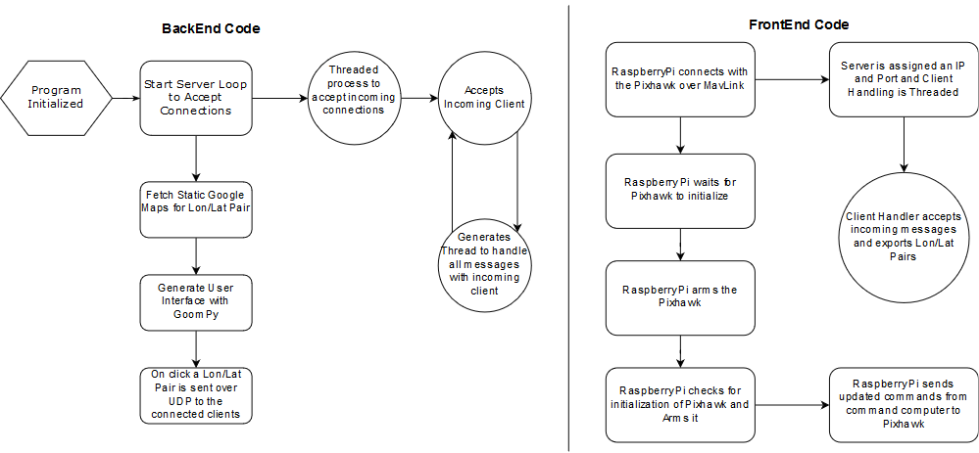
Software - Backend Server
Starts UDP Server
Handles client messages
Generates a user interface
Notes:
Ethan

Slide 14
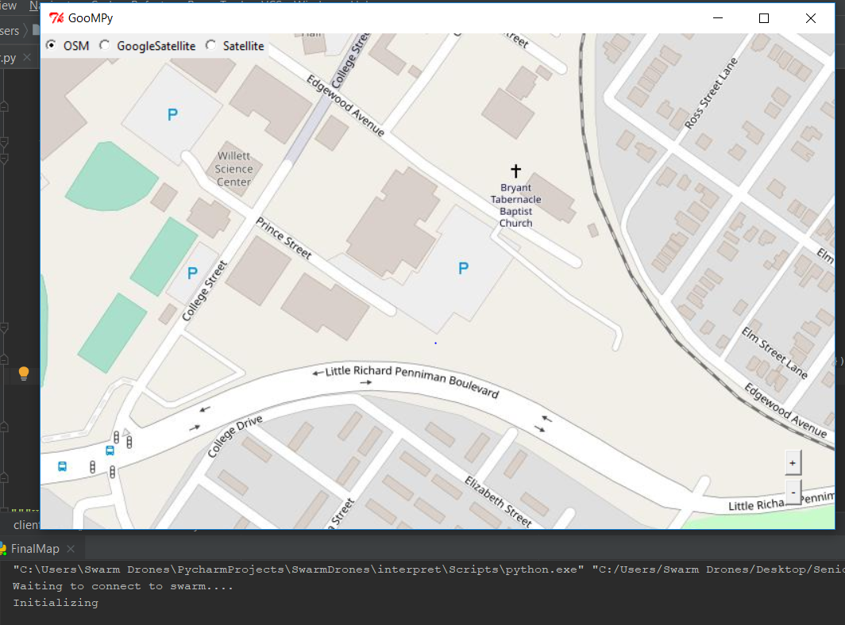
Notes:
Ethan

Slide 15
Software - Frontend Client
Sends and receives messages over Wi-Fi
Controls the flight controller and receives parameters
Notes:
Ethan

Slide 16
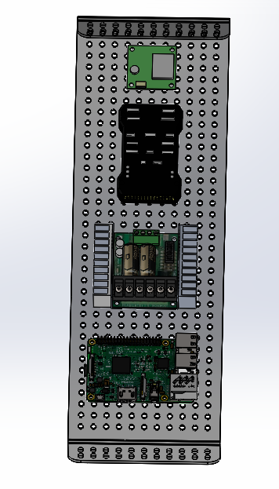

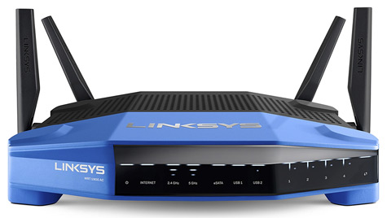
Digital Components of Swarm System
3DR GPS Module
Pixhawk
Sabertooth Motor Controller
RaspberryPi (Wi-Fi equipped)
Command Computer
Linksys Router
IEEE 802.11n (Range: ~270 yards)
Notes:
Ethan

Slide 17
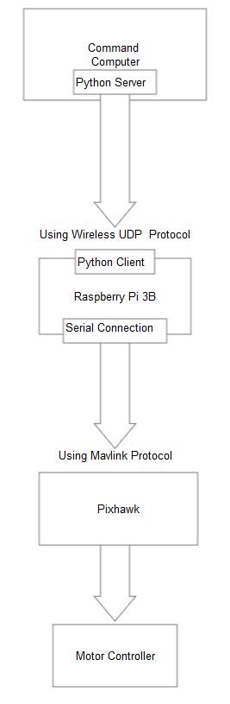
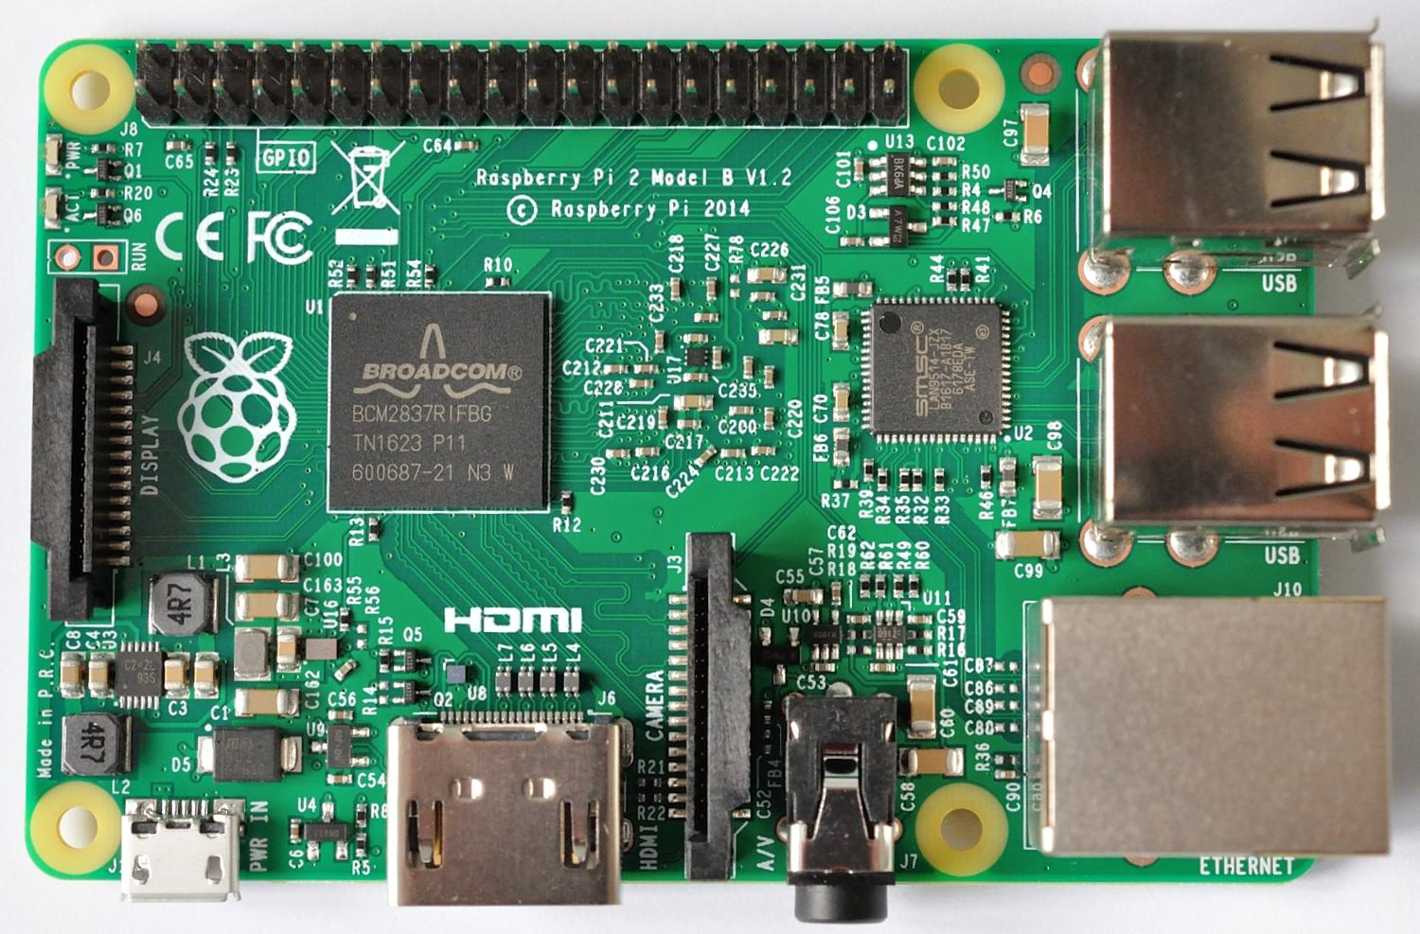
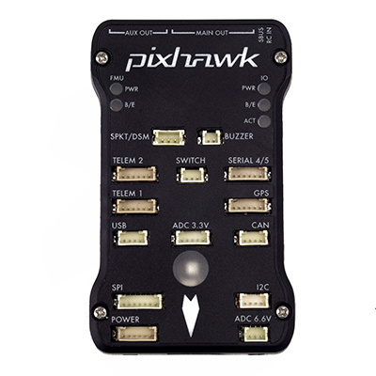
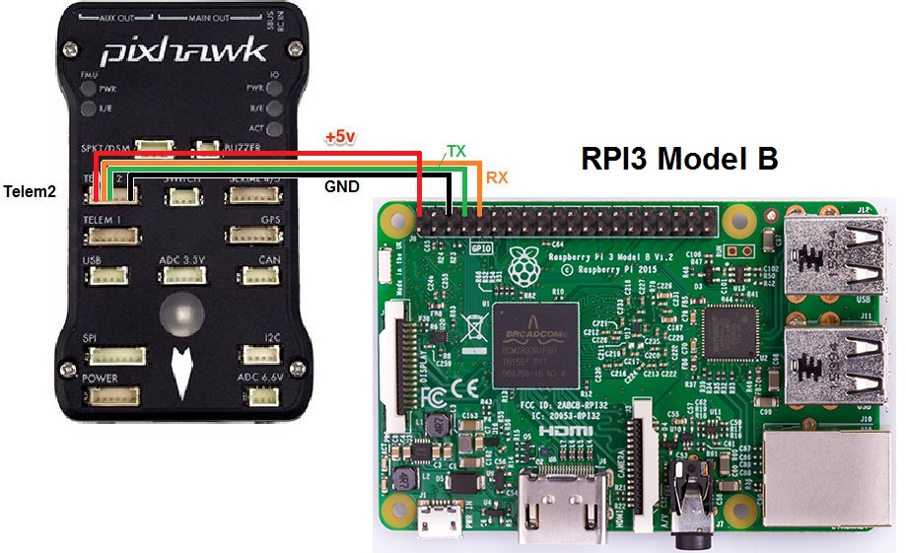
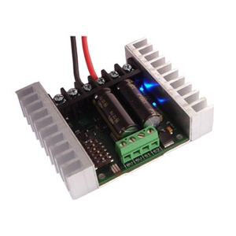
Schematic of Digital Communication
Notes:
Ethan

Slide 18
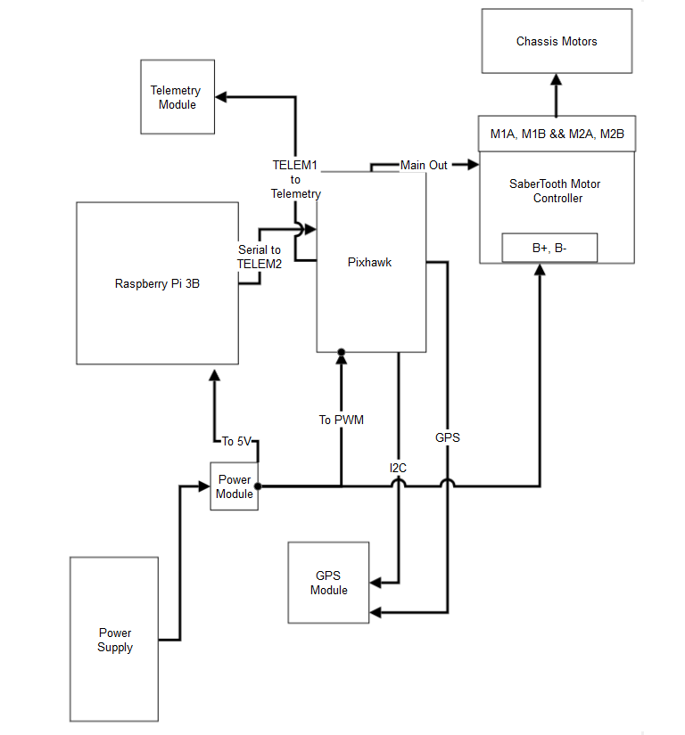
Rover Wiring Diagram
Notes:
Ethan

Slide 19
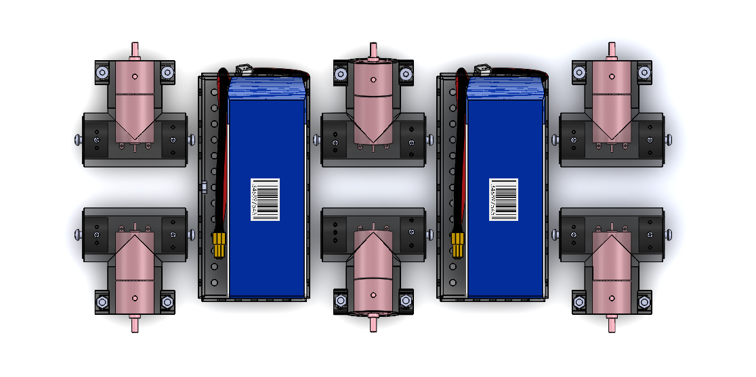
Power Supplies of Rovers
Pololu DC Gearmotor
6 brushed DC motors
75:1 metal spur gearbox
4mm driveshaft
Yowoo 5200mAh Li-Po
7.4V 2C lithium polymer
connected in parallel
Notes:
Daniel

Slide 20
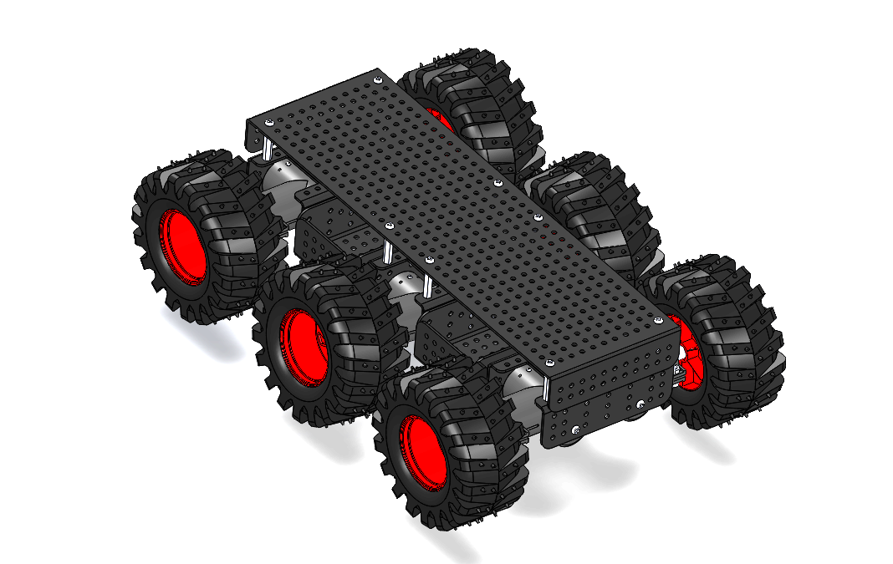
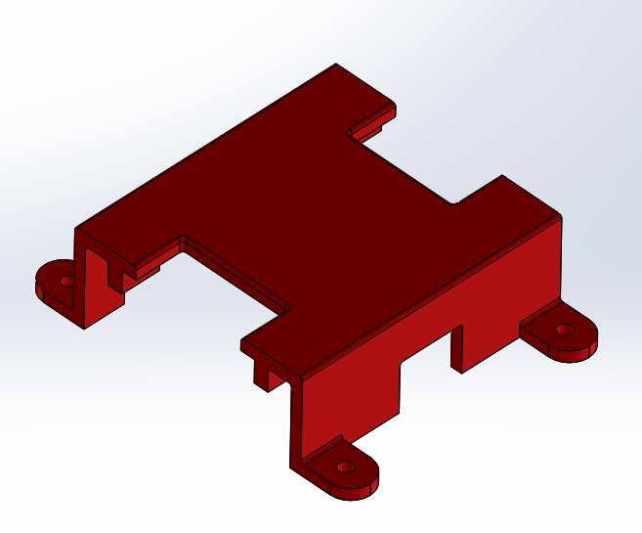
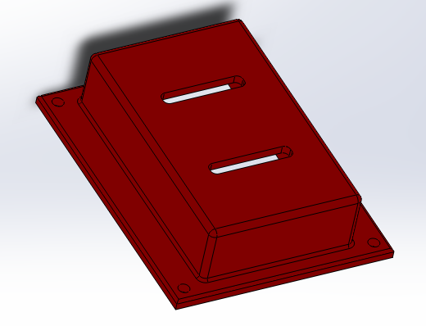
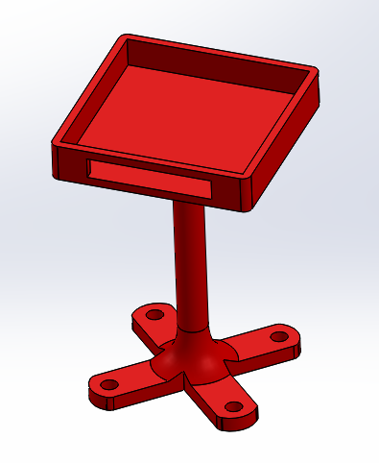
Mechanical Components of Rovers
Wild Thumper 6WD Chassis
Daigu Electronics ©️
M4 hex fasteners and locking nuts
3D-printed Auxiliary Housings
secure external components to chassis
Chassis Assembly [3]
GPS Module
Sabertooth 2x25
Pixhawk
Notes:
Image is too dark, get pics of 3D prints

Slide 21
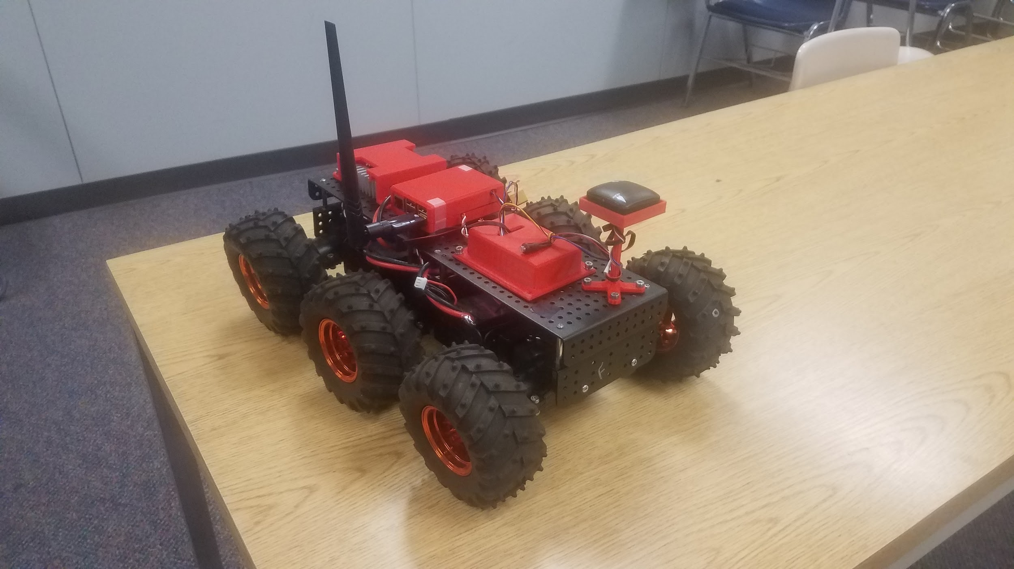
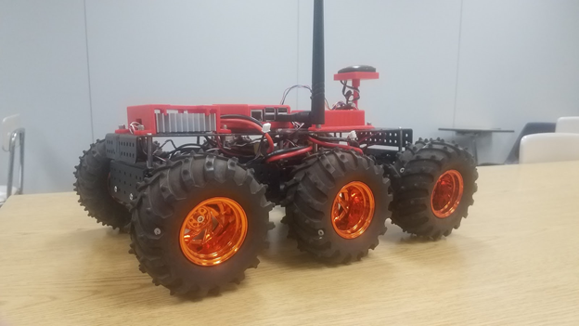
Final Rover Prototype

Slide 22
Checks, Tests, & Results

Slide 23
Equipment/Software Checks
Check | Assessment (yes/no)
Equipment Inventory | All necessary equipment is attained for rover assembly and mission execution
Nominal Battery Voltage | All batteries measure the nominal voltage when charged
Motor Function | Each motor spins with provided power
Radio Telemetry Function | Throttle applied by radio transceiver runs motors
RaspberryPi / Pixhawk Compliance | Flight controller receives and acknowledges MAVLink protocols from companion computer and companion computer reads flight controller attributes
Command Computer Connection | Command computer sends/receives packets to/from the router after using a ping command
RaspberryPi Connection | Companion computer sends/receives packets to/from the router and command computer after using a ping command

Slide 24
Tests Performed
Test | Measured Parameter(s)
Maximum Velocity | Time taken to travel specific intervals of distance at full throttle
Program Boot Time | Average time for rover to connect to server and receive commands
*Path Coherence | Actual distance travelled over the course of a mission as to be compared with an ideal value
*Arrival Time Discrepancy | Total mission time as to be compared with an ideal value
*Swarm Tightness | Average distance between multiple rovers at any given time during a mission
* Autonomous Mission Parameters
Notes:
Danny

Slide 25
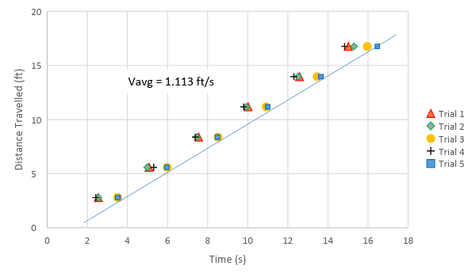
Maximum Velocity Test
5 trials; 6 recorded times over intervals of 9.16 ft
Average at Full Throttle: 1.113 ± 0.006 ft/s
Notes:
Danny

Slide 26
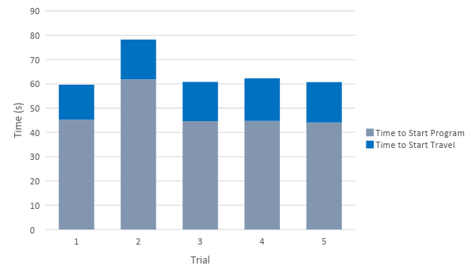
Time Study of Program Initialization
Average to for Rover to connect: 48 ± 8 s
Average time for Rover to run: 64 ± 8 s
Higher deviations were observed for additional rovers
Notes:
Higher deviations: from this we assume that waiting longer than 2 minutes means there is a problem

Slide 27
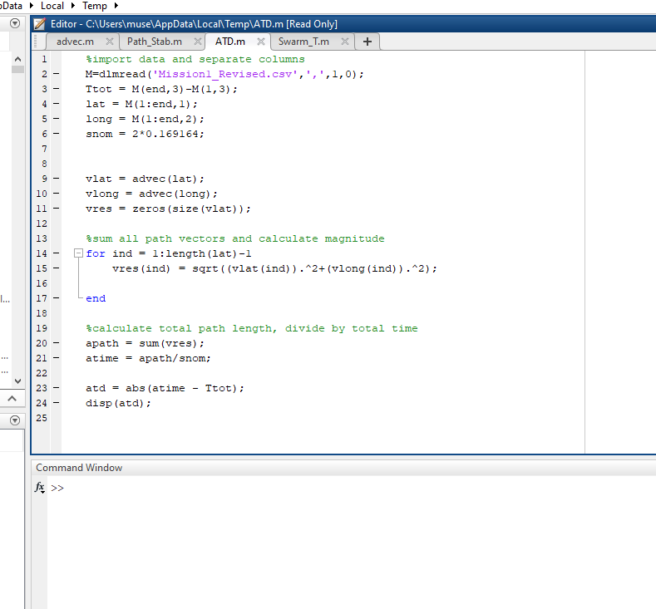
Calculating Autonomous Mission Parameters
Live GPS location was recorded to a .csv file on the RaspberryPi
Rovers’ paths were imported into MatLab as well as Google Maps for analysis
Path Coherence & Arrival Time Discrepancy were calculated for every recorded path
Swarm Tightness was measured only for multi-rover missions

Slide 28
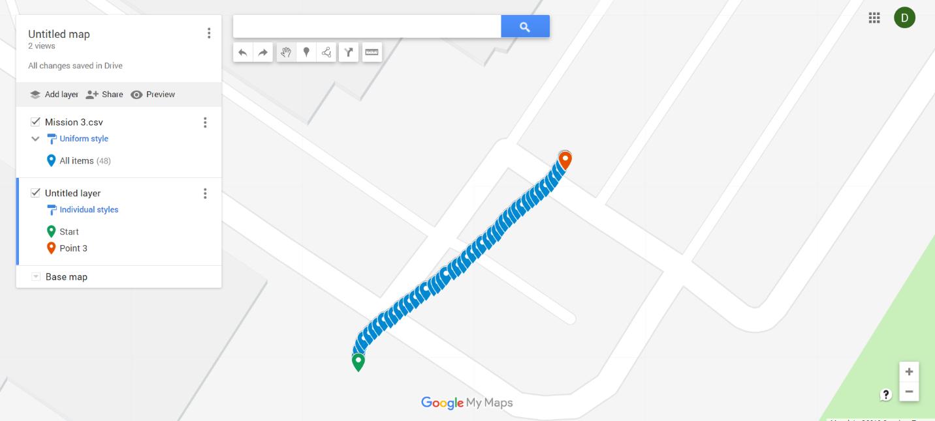
Go-To Mission
Rover received command to travel Northeast
Path Coherence: 0.975
Arrival Time Disc: 94.17s
Indicates Rover was slower than speculated
Notes:
Danny

Slide 29
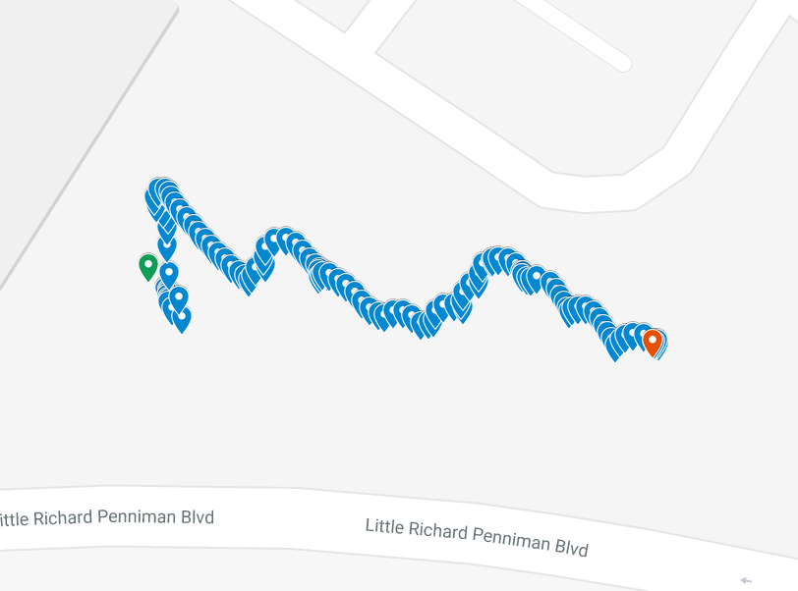
Isolated Waypoint Mission
Destination specified on command computer
Path Coherence: 0.576
Arrival Time Disc: 236.54 s
Several path corrections, mission terminated before destination was reached

Slide 30
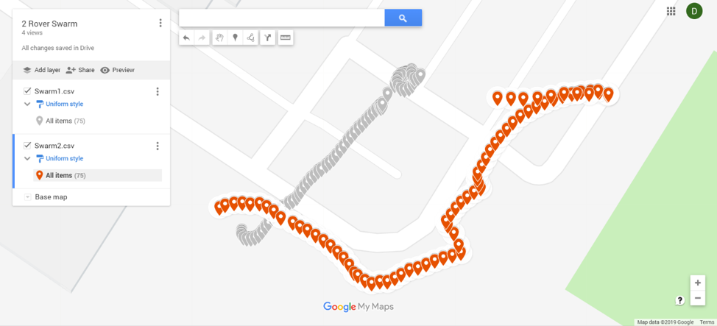
2-Rover Waypoint Mission
Path Coherence
Grey: 0.757
Red: 0.469
Arrival Time Disc
Grey: 148.26 s
Red: 148.26 s
Swarm Tightness: 28.07 m
Notes:
Danny - identical ATD indicates that red rover was much faster

Slide 31
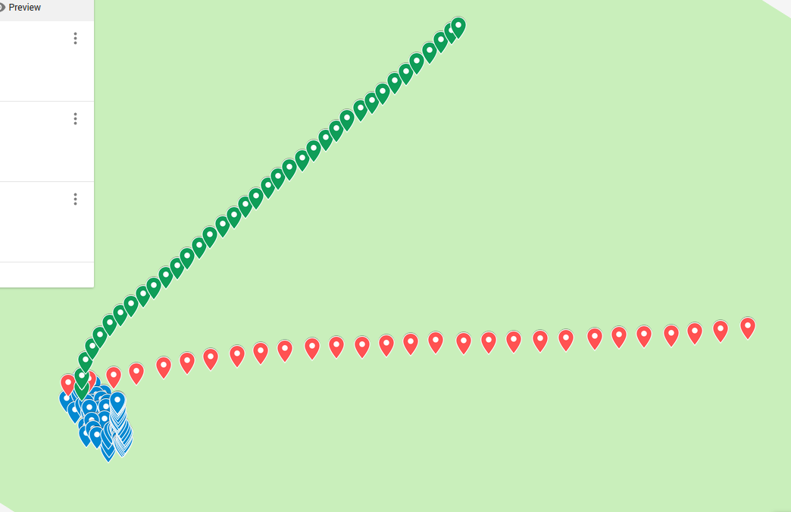
3-Rover Waypoint Mission
Path Coherence
Blue: 0.038
Red: 0.999
Green: 0.983
Arrival Time Disc
Blue: 164.3 s
Red: 54.1 s
Green: 72.2 s
Swarm Tightness
BR: 26.15 m
RG: 18.34 m
GB: 16.44 m
Notes:
Blue: could not find its way
R&G: could not agree on waypoint

Slide 32
Safety & Sustainability Discussion

Slide 33
Considerations for Safe Operation
Safety | Description
Safety Switch | The rover comes equipped with a safety switch that is able to override all commands on the pixhawk and immobilize the vehicle.
Traffic/Surrounding Awareness | One must always maintain spatial awareness.
Electrical Shock | The electrical system of the rover is mostly exposed.
Li-Po Batteries | The dangers of Li-Po batteries are real.
Notes:
The rover comes equipped with a safety switch that is able to override all commands on the pixhawk and immobilize the vehicle. In case of erratic behaviors, turn off the safety switch.
The rover is an exciting bit of engineering; however, one must always maintain spatial awareness. If in parking lot, take extra precautions to avoid traffic.
The electrical system of the rover is mostly exposed. If any modifications are made to any connections or open electricals, turn off the power.
The dangers of Li-Po batteries are real. If not properly charged, the batteries have a potential to ignite, or worse, explode. The integrity of the battery must be checked constantly. If a Li-Po battery begins to expand, dispose of the battery properly.

Slide 34
Major Factors Affecting Sustainability
Vulnerabilities | Description
Motor Life | Brush failure due to contaminants, such as dirt and moisture, as well as a high number of discharge cycles
Erosion | Main chassis and auxiliary housings experienced noticeable wear
Environmental Exposure | Moisture and ultraviolet (UV) radiation wearing down electronic housings or 3D printed parts
Creep | Improper mounting and ill-fitted equipment can manifest into steady deformation over time
Notes:
Daniel
With such an involved design, it is necessary to discuss the factors that affect the sustainability of the system as a whole. Outlined below are factors that weigh heavily on the approximate lifespan of the swarm system from this point on. The team made careful observations of various components as they were used continually. By extrapolating these observations back to the inception of this project, the team compiled approximations for the following matters.
Motor Life
As mentioned in Section 2, the team experienced two modes of motor failure: bad brushes (presumed) and broken pinions. Brush failure was most likely due to contaminants, such as dirt and moisture, as well as a high number of discharge cycles. As for the pinions, it was observed that individual teeth had sheared off, resulting almost certainly from a high-magnitude, fully reversing load.
Erosion
Over the course of the project, the rovers were disassembled and reassembled on a daily basis. As consequent of the troubleshooting and debugging, the main chassis and auxiliary housings experienced noticeable wear. For example, swapping motors resulted in gouges along the inner rim of the plastic motor housings reducing the integrity of the housing. Another area of erosion is the aluminum chassis eroded by the unfastening and refastening of body panels.
Environmental Exposure
Rovers must have clear sky access to achieve a GPS lock, therefore it is assumed that all missions are to be outdoors. This being said, there are several areas of the rovers’ design that are vulnerable to damage from environmental exposure.
The two greatest threats to the rovers are moisture and ultraviolet (UV) radiation. Although much of the on-board equipment is encased to some degree, there are several exposed electrical connections. Most notable are the serial connections between the motor controller, flight controller, GPS module, and RaspberryPi atop the rover chassis. Water has an opportunity to contact these connections, be it from rain, tire spray, or, terrifyingly, complete submersion. Also, UV exposure has the opportunity to degrade the many plastics spanning the rover body.
Creep
Creep in the rovers’ chassis was a frequent problem with assembly and disassembly. Most notably, the aluminum plates atop the rover chassis did not fit properly to its mounting posts. It is believed that improper equipment mounting from previous assemblies induced internal stresses on the chassis that manifested in steady deformation over the time of project inactivity.
Deformation in body panels is minimal; therefore, the team does not see creep causing the chassis to fail any time soon. However, the parts created using 3D printing technology are predicted to be highly influenced by creep. This combined with the UV wear on the parts is predicted to cause rapid deformation over time.

Slide 35
Conclusion, Critiques, & Recommendations

Slide 36
In Summation,
A central command computer and three autonomous vehicles were delivered.
Autonomous control was achieved for all three rovers
GPS tracking was utilized
Wi-Fi allows for travel out to approx. 270 yards
Notes:
Dr. Anthony Choi has expressed his desire for the development of a system of GPS guided robots that swarm a designated location at the click of a button. The project, on-going in recent years, has seen the implementation of small ground rovers with user-inputted GPS waypoints. R.E.D. Design has received this project from Dr. Choi via the Mercer School of Engineering. R.E.D. Design has appointed Roy Wood, Ethan Daily, and Daniel Minch, a group of engineers specializing in programming, computer science, and mechanical design, to further develop the project to new and further ground.
R.E.D. Design has created a new swarm system that utilizes ground rovers using companion computers and wireless networking.This configuration results in the instant transfer of commands while also allowing heavy computations to be made quickly by both the command and the companion computers due to the breakdown of workload. Connecting multiple drones is trivial due to each drone only requiring the ability to connect to a wireless access point to become part of the swarm. By utilizing network protocol and having a central server connected to an access point, R.E.D. Design hopes to pave the way for an Internet of Things swarm system. Connection to any number of drones at once would be possible by using dynamically assigned identification of each rover with address resolution. The rovers will be intelligent as each rover is equipped with a companion computer that is constantly communicating with the other rovers and will be able to adjust its course based on the information available. R.E.D. Design was able to conduct multiple missions using the system. The results of the missions are given in the next paragraph.
During initial testing, the nominal max velocity was calculated to be 1.113 ft/s. The stimulus response with boot time was measured to be 64.33 seconds. The path stability of Mission 1 was 1.7353, which means the rover travels along a path that is about 1.73 times longer than the straight-line distance. The arrival time discrepancy was 236.5416 seconds, which can be described as the amount of time the rover actually took to get to the location minus the expected amount of time to get to the location. The path stability of Mission 3 was 1.2056, which is about 120% of the actual distance to the location. The arrival time discrepancy was 94.1668 seconds. The Swarm Mission contained two paths. The first path had a path stability of 1.3203, which is about 132% of the actual distance to the location. The arrival time discrepancy of the first path was 148.26 seconds. The seconds path had a path stability of 2.1344, which is about 213% of the actual distance to the location.
While the potential for this system is very large, it has its drawbacks. The system is prone to a small range due to the wireless adapters and the wireless router. The system also suffers from a slight mapping error which requires a greater breakdown of the google maps API in order to implement more accurately. The system also uses the Wild Thumper Chassis which was found to be unstable and required many changes to function acceptably.

Slide 37
Critiques of Final Performance
The shortcomings of the system are:
Not all Rovers follow a waypoint attributed to bad GPS/Compass Module
Swarm Behavior is primitive
Notes:
Dr. Anthony Choi has expressed his desire for the development of a system of GPS guided robots that swarm a designated location at the click of a button. The project, on-going in recent years, has seen the implementation of small ground rovers with user-inputted GPS waypoints. R.E.D. Design has received this project from Dr. Choi via the Mercer School of Engineering. R.E.D. Design has appointed Roy Wood, Ethan Daily, and Daniel Minch, a group of engineers specializing in programming, computer science, and mechanical design, to further develop the project to new and further ground.
R.E.D. Design has created a new swarm system that utilizes ground rovers using companion computers and wireless networking.This configuration results in the instant transfer of commands while also allowing heavy computations to be made quickly by both the command and the companion computers due to the breakdown of workload. Connecting multiple drones is trivial due to each drone only requiring the ability to connect to a wireless access point to become part of the swarm. By utilizing network protocol and having a central server connected to an access point, R.E.D. Design hopes to pave the way for an Internet of Things swarm system. Connection to any number of drones at once would be possible by using dynamically assigned identification of each rover with address resolution. The rovers will be intelligent as each rover is equipped with a companion computer that is constantly communicating with the other rovers and will be able to adjust its course based on the information available. R.E.D. Design was able to conduct multiple missions using the system. The results of the missions are given in the next paragraph.
During initial testing, the nominal max velocity was calculated to be 1.113 ft/s. The stimulus response with boot time was measured to be 64.33 seconds. The path stability of Mission 1 was 1.7353, which means the rover travels along a path that is about 1.73 times longer than the straight-line distance. The arrival time discrepancy was 236.5416 seconds, which can be described as the amount of time the rover actually took to get to the location minus the expected amount of time to get to the location. The path stability of Mission 3 was 1.2056, which is about 120% of the actual distance to the location. The arrival time discrepancy was 94.1668 seconds. The Swarm Mission contained two paths. The first path had a path stability of 1.3203, which is about 132% of the actual distance to the location. The arrival time discrepancy of the first path was 148.26 seconds. The seconds path had a path stability of 2.1344, which is about 213% of the actual distance to the location.
While the potential for this system is very large, it has its drawbacks. The system is prone to a small range due to the wireless adapters and the wireless router. The system also suffers from a slight mapping error which requires a greater breakdown of the google maps API in order to implement more accurately. The system also uses the Wild Thumper Chassis which was found to be unstable and required many changes to function acceptably.

Slide 38
Recommendations for Future Development
Improve rover chassis and motors
Addition of more information gathering equipment
Use live path calculations for frontend feedback
Mobile hotspot
GPS module re-evaluation/RTK GPS implementation
Notes:
Through all of the time spent working on the swarm system, R.E.D. Design recommends an improvement of the rover chassis, specifically to be able to handle more complicated terrain and protect from moisture and debris. Furthermore, more equipment should be added as the chassis is robust enough to seat more gadgets, such as video or echolocation, and to supplement such gadgets with integrated commands to the system. The system could accept the addition of aerial drones with few modifications; aerial drones are recommended to nullify the complex ground terrain. R.E.D. Design also recommends the integration of a mobile hotspot to allow for drone access outside of the range of the router. This would also pave the way for an Internet of Things integrated swarm system. Most importantly to improve the performance of the system, the GPS satellite navigation must be reevaluated. R.E.D. Design recommends the integration of Real Time Kinematic (RTK) satellite navigation. This would improve the resolution of the vehicles’ GPS location down to the centimeter level.

Slide 39
Questions?

Slide 40
References
1. Alosaimi K., Bennett K., DeWitt W., (2017). Swarm Robotics: Senior Design Critical Review
2. Fadilah, S. I., Shibghatullah A. S., Abas Z.A., Wahab M. H. A. and Hashim W. N. W., PERFORMANCE ANALYSIS FOR WIRELESS G (IEEE 802.11G) AND WIRELESS N (IEEE 802.11N) IN OUTDOOR ENVIRONMENT. ARPN Journal of Engineering and Applied Sciences (2014). Retrieved from http://www.arpnjournals.com/jeas/research_papers/rp_2014/jeas_1014_1241.pdf
3. Pamir (2013), Wild Thumper 6WD Chassis [SLDASM]. Retrieved from https://grabcad.com/library/wild-thumper-6wd-chassis-1/details?folder_id=4281587
4. Dagu Wild Thumper 6WD All-Terrain Chassis, Black, 75:1. Pololu Corporation (2019). Retrieved from https://www.pololu.com/product/1563
5. Ardupilot / ardupilot. GitHub Incorporated (2019). Retrieved from https://github.com/diydrones/ardupilot/blob/master/Tools/autotest/common.py

